Slide 1

Netflix Data Analysis Project
Chandramouleshwar J
INTERNSHIP_17546440516895be537820f

Slide 2

PROBLEM STATEMENT
Netflix has become one of the most prominent global streaming platforms, continuously expanding its library with a mix of original productions and licensed content. However, with growing competition from platforms like Amazon Prime, Disney+, and regional OTT providers, Netflix must strategically analyze its content catalog to identify strengths, gaps, and opportunities.
The specific problem to be addressed in this project is 'Content Trends Analysis for Strategic Recommendations'. The aim is to uncover how Netflix’s content distribution (Movies vs. TV Shows, genres, and country contributions) has evolved over the years. This will enable the identification of key genres, audience preferences, and strategic insights into global content expansion.

Slide 3
PROJECT DESCRIPTION
This project focuses on analyzing Netflix’s vast catalog of Movies and TV Shows to uncover content trends and strategic insights. Using data from 2008–2021, the analysis explores how content distribution across genres, countries, and formats (Movies vs. TV Shows) has evolved over time.
The goal is to identify popular and underrepresented genres, assess country-wise contributions, and understand Netflix’s global content strategy. By examining these trends, the project provides data-driven recommendations to help Netflix refine its content acquisition, production, and audience engagement strategies.
The outcomes aim to offer a clear picture of Netflix’s evolving catalog, highlight top-performing content categories, and support strategic decision-making in an increasingly competitive OTT landscape.

Slide 4

WHO ARE THE END USERS?
Netflix Content Strategy Team – to identify trends and make data-driven decisions on future content acquisition and production.
Marketing and Regional Operations Teams – to understand audience preferences and tailor regional campaigns.
Data Analysts and Business Intelligence Teams – to leverage insights for performance monitoring and strategic planning.
Researchers and Media Analysts – to study OTT industry trends and audience behavior patterns.

Slide 5

TECHNOLOGY USED
  Python - Core Programming Language
  Data Cleaning and Preprocessing – PANDAS, NumPy
  Data Visualization - Matplotlib
  Anaconda Jupyter Notebook – Open-Source Web Application to run Python code.

Slide 6
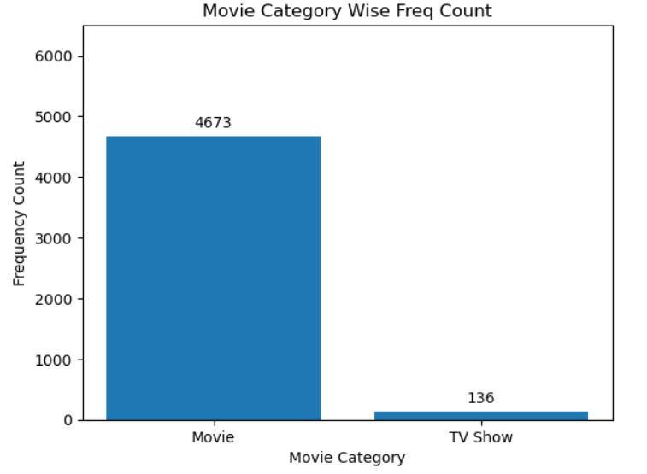
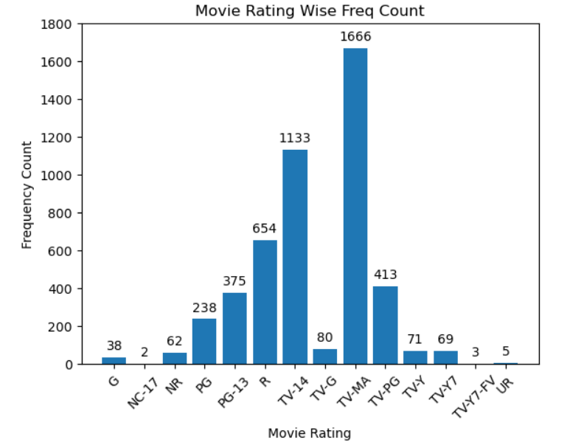
RESULTS1

Slide 7
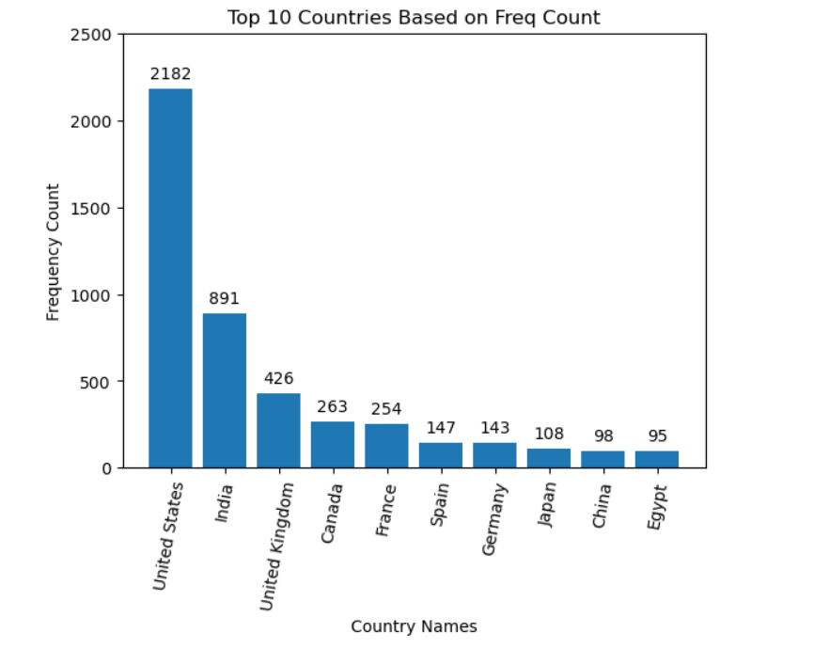
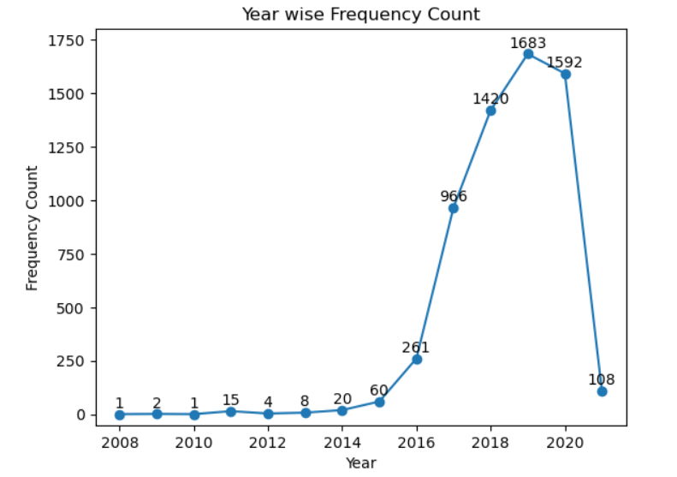
RESULTS2
Year Wise Movie Releases

Slide 8
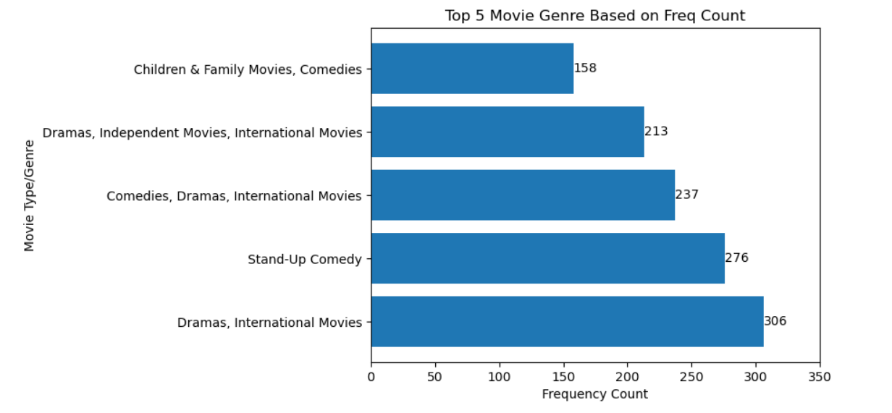
RESULTS3

Slide 9
GitHub repository
https://github.com/ChanduCyber05/VOIS_AICTE_Oct2025_MajorProject_ChandramouleshwarJ.git

Slide 10

Getting started with Basics of Python Certificate

Slide 11
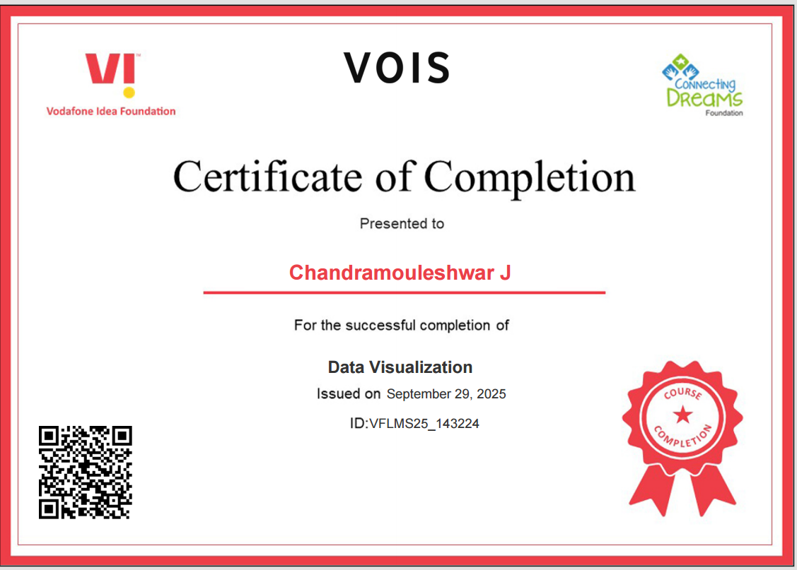
Data Visualization Certificate

Slide 12
Thank you

